Slide 1
Forecast & Clustering
Infant and Maternal Mortality Indicators
In Colombia
July 17, 2020
By Andrés Segura

Slide 2
Time Series
SARIMA and Holt-Winters

Slide 3
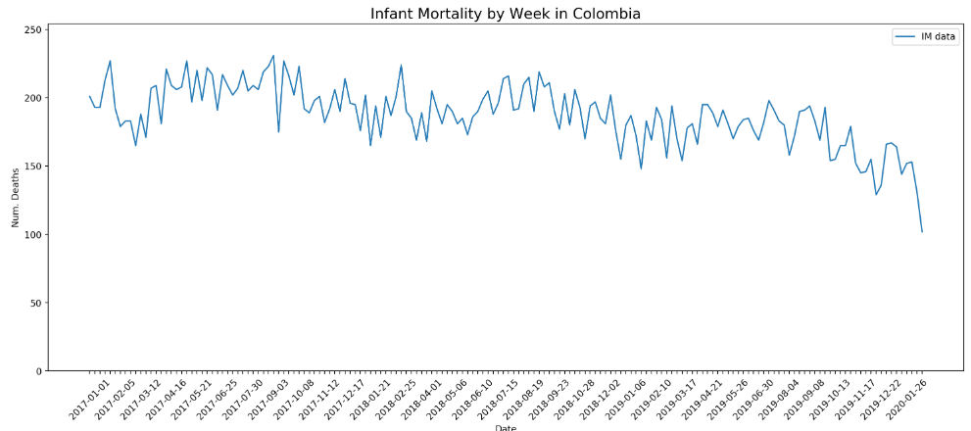
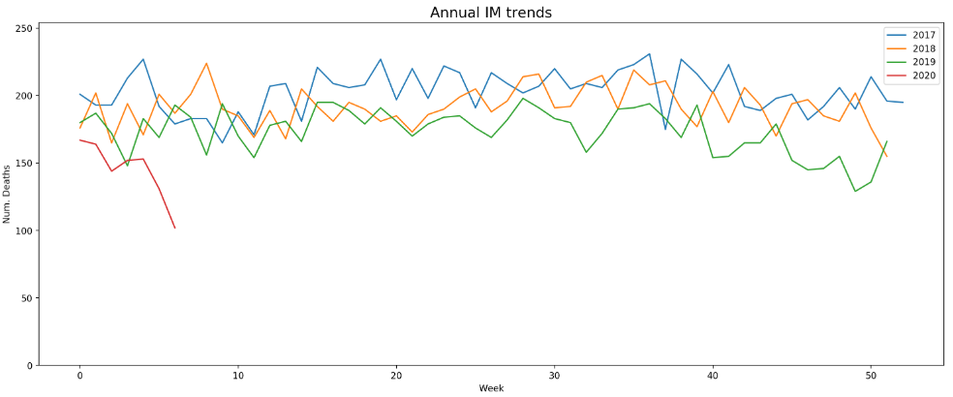
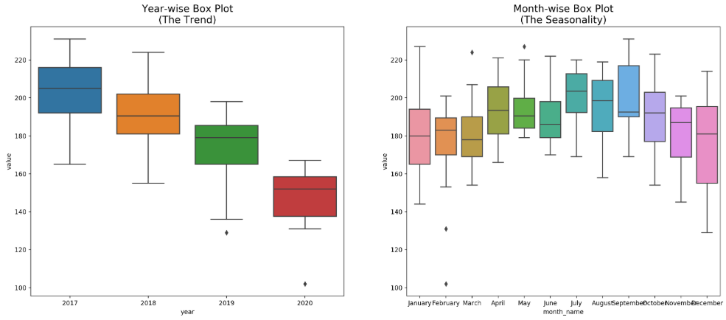
Infant Mortality (IM)
Data:
2017, 2018, 2019 & 2020 Q1
Stats:
Max: 231
Min: 102
Std.Dev.: 21.69 (16.82%)

Slide 4
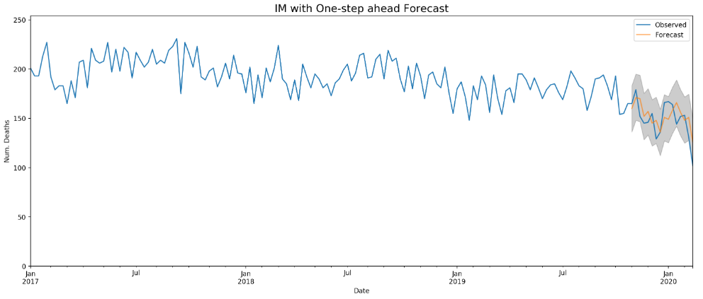

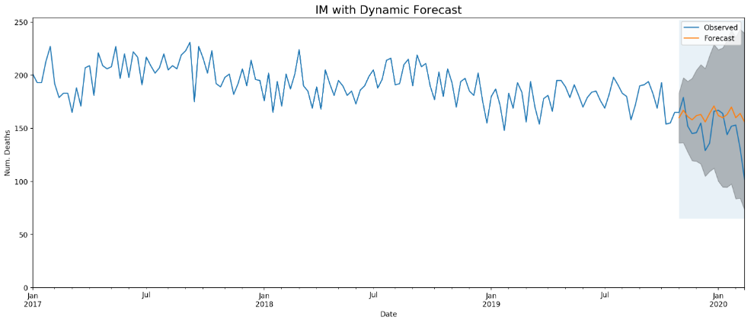

MI - Training SARIMA

Slide 5
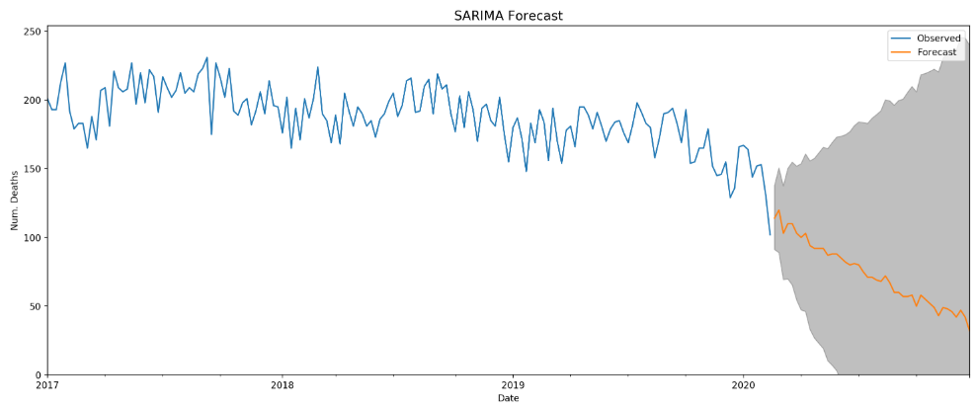
MI - SARIMA Forecast
Best configuration (2, 2, 2) x (1, 0, 2) x 52

Slide 6
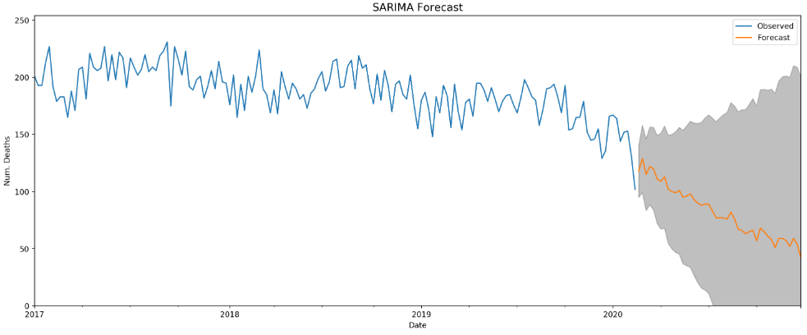
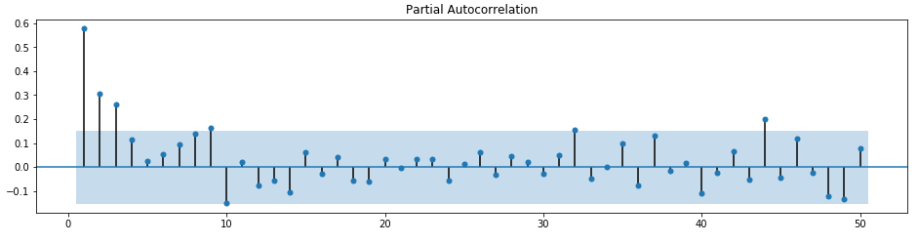
MI - SARIMA Forecast
Selected configuration (4, 2, 1) x (1, 0, 2) x 52

Slide 7
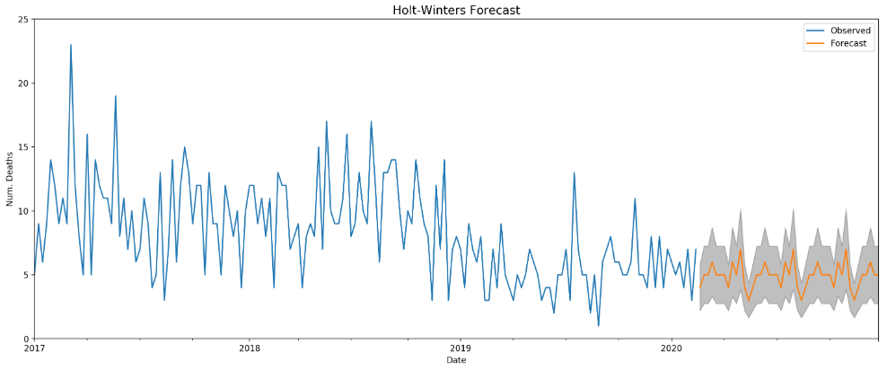
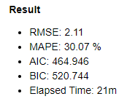
MI - HW Forecast

Slide 8
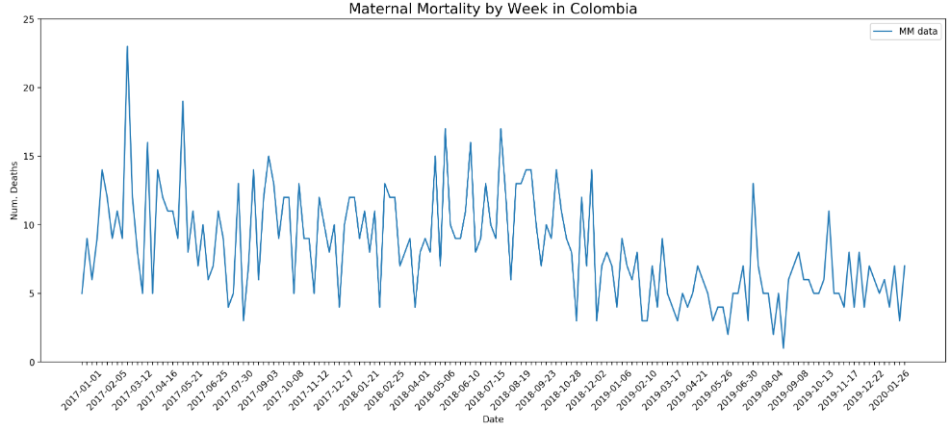
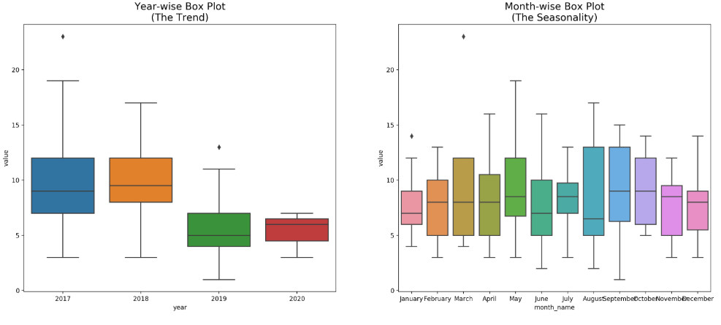
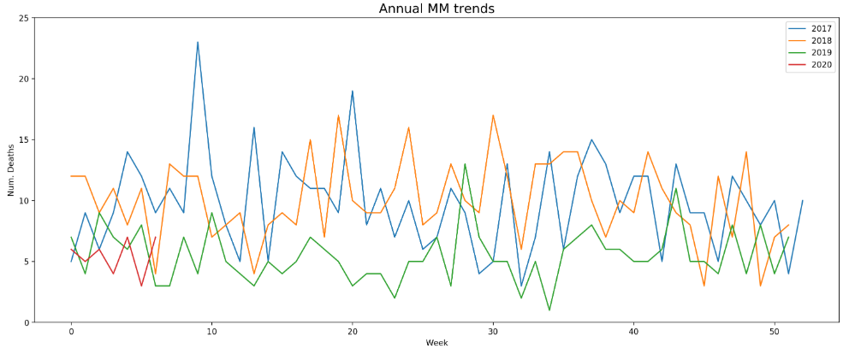
Maternal Mortality (MM)
Data:
2017, 2018, 2019 & 2020 Q1
Stats:
Max: 23
Min: 1
Std.Dev.: 3.77 (17.15%)

Slide 9
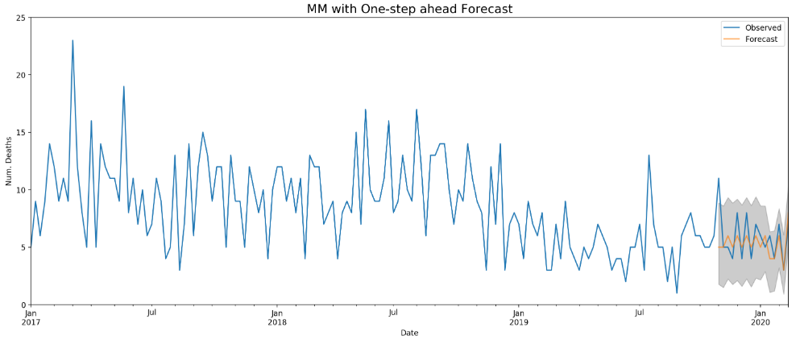

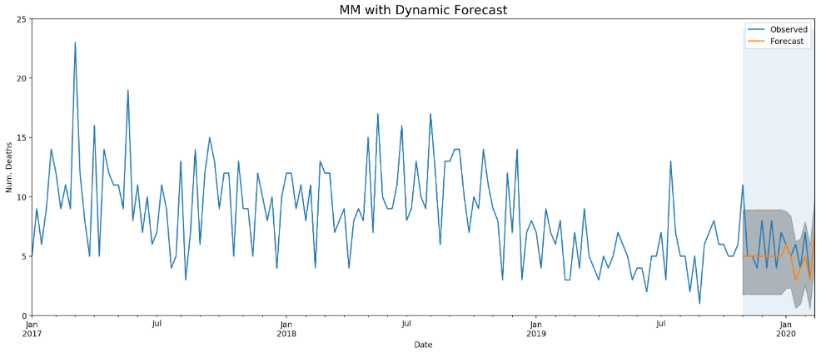

MM - Training SARIMA

Slide 10
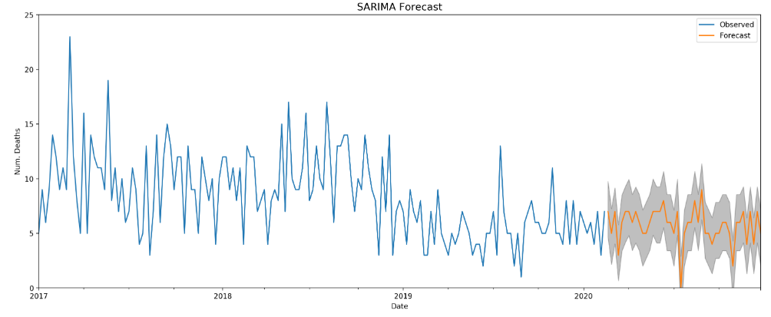
MM - SARIMA Forecast

Slide 11
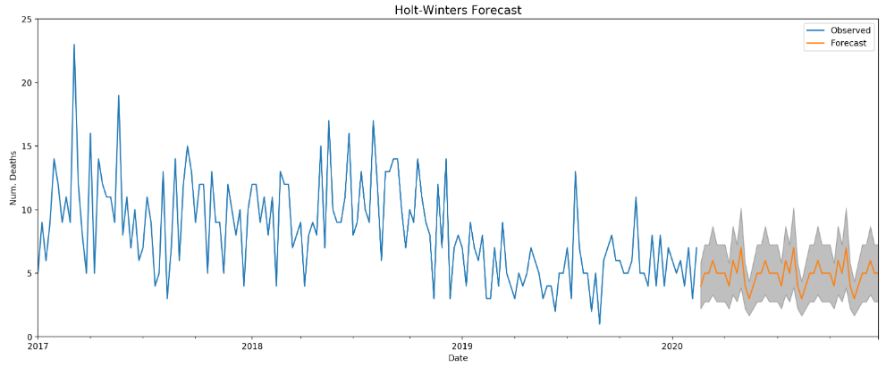
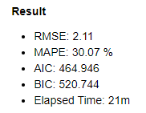
MM - HW Forecast

Slide 12
Clustering
K-Means
By Departments
(32 Departments + 1 DC)

Slide 13
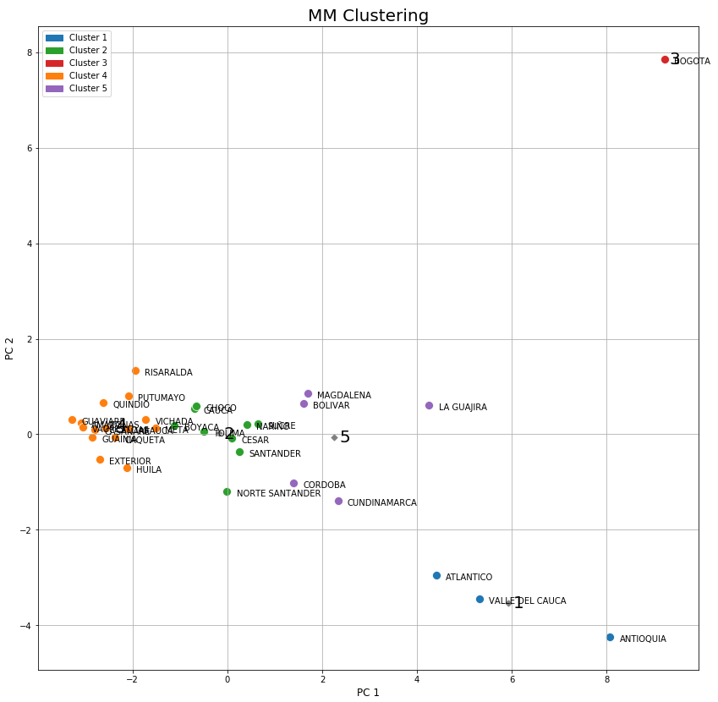
MM Clustering: K-Means

Slide 14
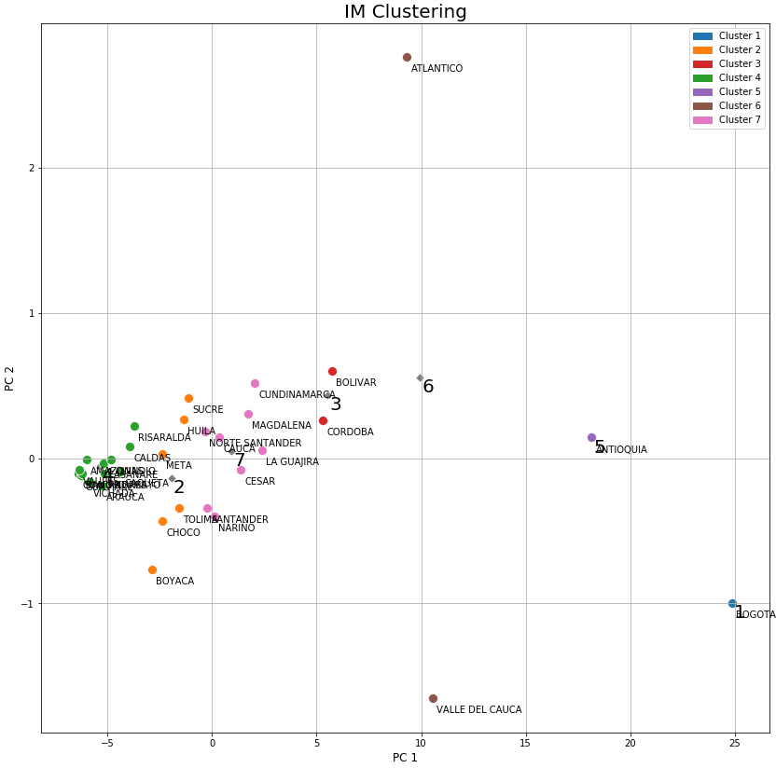
IM Clustering: K-Means

Slide 15
Let’s go to Jupyter Notebook
and thank you!

